Slide 1
HOUSE
DŮM

Slide 2
ROOF [ruːf]
CHIMNEY [ˈtʃɪmnɪ]
WINDOW [ˈwɪndəʊ]
DOOR [dɔː]

Slide 3
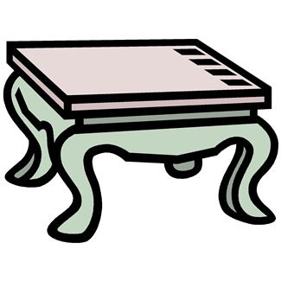
LIVING ROOM [ˈlɪvɪŋ rʊm]
SOFA [ˈsəʊfə]
ARMCHAIR [ˈɑːmˌtʃeə]
COFFEE TABLE
[ˈkɒfɪ ˈteɪbəl]
TELEVISION [ˈtelɪˌvɪʒən]
CARPET [ˈkɑːpɪt]

Slide 4
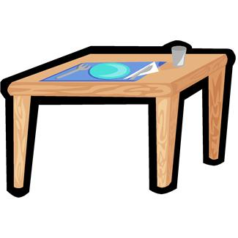
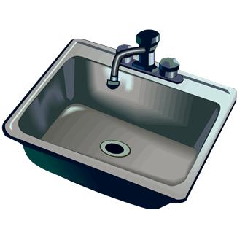
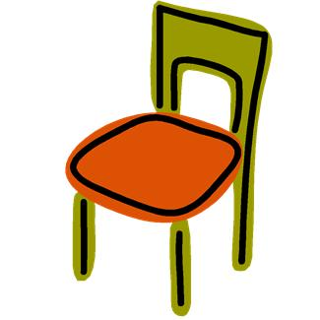
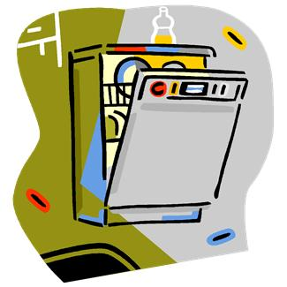
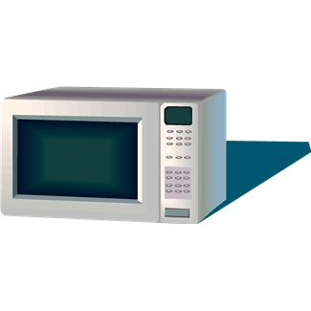
KITCHEN [ˈkɪtʃɪn]
TABLE [ˈteɪbəl]
SINK [sɪŋk]
CHAIR [tʃeə]
DISHWASHER [ˈdɪʃˌwɒʃə]
MICROWAVE [ˈmaɪkrəʊˌweɪv]
COOKER [ˈkʊkə]

Slide 5
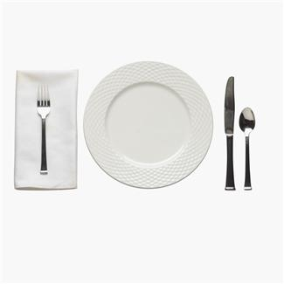
PLATE [pleɪt]
KNIFE [naɪf]
FORK [fɔːk]
SPOON [spuːn]

Slide 6
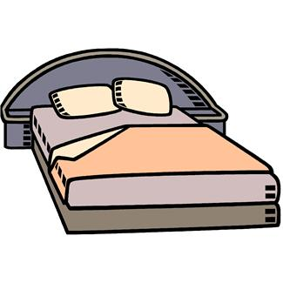
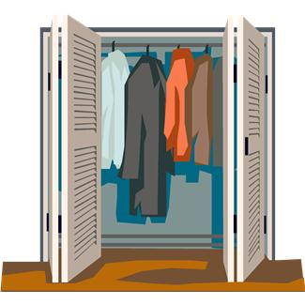
BEDROOM [bed rʊm]
BED [bed]
LAMP [læmp]
WARDROBE [ˈwɔːdrəʊb]
BEDSIDE TABLE [ˈbedsaɪd ˈteɪbəl]
MIRROR [ˈmɪrə]

Slide 7
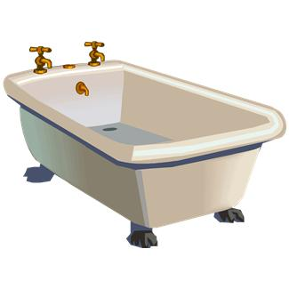
BATHROOM [bɑːθ rʊm]
BATH [bɑːθ]
MIRROR [ˈmɪrə]
SHOWER [ˈʃaʊə]
TOILET [ˈtɔɪlɪt]
WASHBASIN [ˈwɒʃˌbeɪsən]

Slide 8
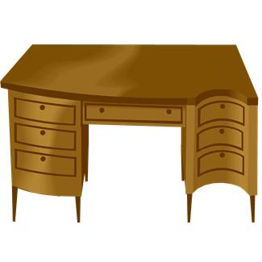
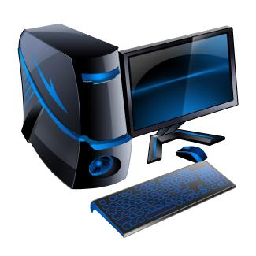
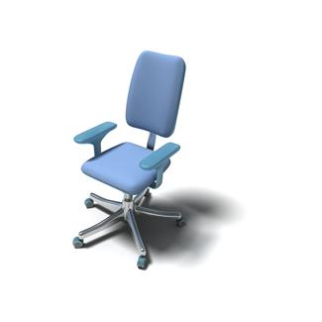
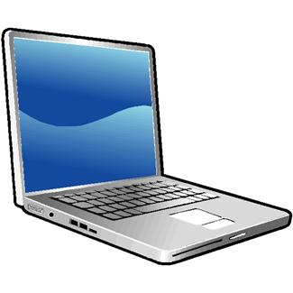
WORKROOM/ STUDY
COMPUTER [kəmˈpjuːtə]
TABLE [ˈteɪbəl]
BOOKCASE [ˈbʊkˌkeɪs]
CHAIR [tʃeə]
NOTEBOOK [ˈnəʊtˌbʊk]

Slide 9
ZDROJ:
http://office.microsoft.com - obrázky

